Slide 1
Playing Clue
Riley Siebel ’11
Advisor: Dr. Robert Schapire

Slide 2
Overview
Implement an algorithm to play the classic board game Clue
Attempt to determine which kind of algorithms play best

Slide 3
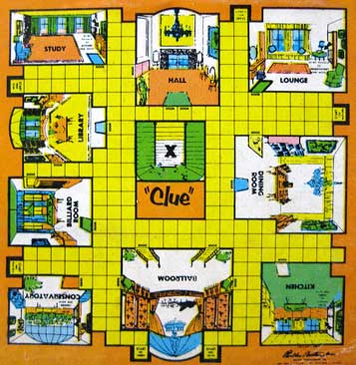
The Game
Divided into squares and rooms
‘Clues’ distributed to players
Attempt to determine which clues were not distributed
Direct Information
Indirect Information
Notes:
Picture from : http://sunnysideofthesunporch.blogspot.com/2010_01_01_archive.html
accessed on October 10, 2010.

Slide 4
The Motivation
What if you want to program a Clue game? Players should be able to play against the computer
Always looking for ways to make better algorithms, better AI

Slide 5
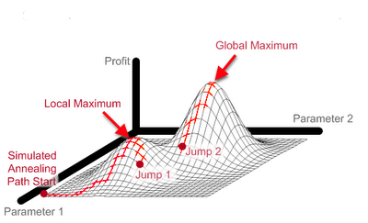
AI Game Playing (1)
Game playing is one of the most well studied areas of AI
Tree/Graph Search
Hill Climbing
Simulated Annealing

Slide 6
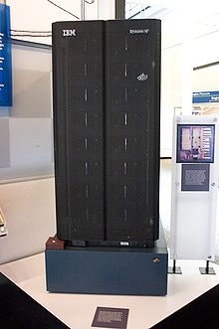
AI Game Playing (2)
Chenghui Cai & Silvia Ferrari (Duke)
Neural Network & Machine Learning Approach to Clue
Deep Blue (1997)

Slide 7
The Goal
Apply AI Game Playing to Clue
Start with simple algorithms, move to more complex
Tree/Graph Search
Hill Climbing
Machine Learning
Time permitting
Play my best algorithm against Duke’s
Make an iPhone game in which the player can play against my algorithm(s)

Slide 8
Roadmap
Start with tree search
Implement the environment where these algorithms will play each other
Attempt to define several potential “objective functions” (Winter Break)
Implement Hill Climbing, try to plug in the objective functions
Run the algorithms against each other & the Duke algorithm

Slide 9
Defining Success
Finish at least two algorithms
Play them against each other, evaluate
Play the best one against Duke’s algorithm
Potentially make a game so you can play both of my algorithms

Slide 10
Challenges
Implementing the environment for the algorithms to duke it out
Getting the team from Duke to give me their implementation
Determining the ‘indirect’ information and its use

Slide 11
Questions?

